Slide 1
E-Mail Spam Classification
YZV 311E “Data Mining” Term Project
Group 8
Abdullah Bilici, 150200330
Bora Boyacıoğlu, 150200310

Slide 2
Growing Importance & Key Limitations
Importance
Limitations
Scams: Individuals
Malware: Compaines
Lots of Junk
Hard to distinguish
Ineffective Algorithms
False Categorising

Slide 3
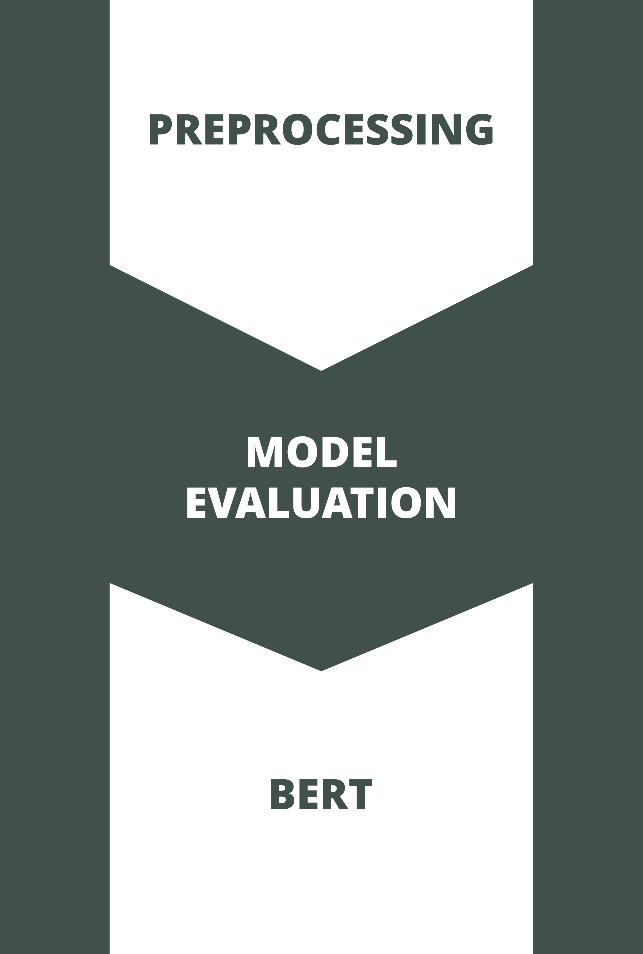
Highlights
Filtering the punctuations, stop-words, etc. after vectorising
Using different models and comparing them for the model
Hyperparameter tuning
Experimenting on a special BERT model

Slide 4

Related Studies
There are important researches and competitive works around for this task.
Big companies like Google, Apple and Microsoft for personal addresses
Smaller companies for their business related services
Kaggle competition in 2011
Our dataset’s model: Harsh Sinha

Slide 5
System Architecture: Pre-Processing
Tokenising
Feature Modelling
Removing stop words and punctuations
Lowercasing
Lemmatisation
TF-IDF
Term Frequency
Inverse Document Frequency
Feature Reduction

Slide 6
System Architecture: Model Creation
Models
Hyperparameter Tuning
Multinomial Naive Bayes
A: 0.86, P: 1.00, R: 0.40, F1: 0.58
Support Vector Machines
A: 0.95, P: 0.99, R: 0.80, F1: 0.89
Random Forest
A: 0.98, P: 0.98, R: 0.93, F1: 0.96
Logistic Regression
A: 0.90, P: 1.00, R: 0.58, F1: 0.74
Random Forest
n_estimators: 400
min_samples_split: 2
min_samples_leaf: 1
max_features: Square Root

Slide 7
System Architecture: BERT
Model Creation
Evaluation
Creation
Training
Loop
Accuracy: 0.98
Precision: 0.96
Recall: 0.94
F1 Score: 0.95

Slide 8
Dataset
Our dataset consists of two columns: text and spam, which contains the email content and an indicator for spam/ham.
There are 5695 rows.
%76 of them are ham, the rest are categorised as spam.

Slide 9
Experimental Results
Random Forest
BERT
After hyperparameter tuning, the results are:
Accuracy : 0.97
Precision: 0.97
Recall : 0.94
F1 Score : 0.95
Using the following properties:
n_estimators: 400
min_samples_split: 2
min_samples_leaf: 1
max_features: Square Root
With 20 epochs and 0.0002 learning rate, the results are:
Accuracy : 0.98
Precision: 0.96
Recall : 0.94
F1 Score : 0.95

Slide 10
Conclusions & Thanks
We got pretty high results, which seems to be the maximum with our limitations.
There are of course more ways to improve these, with much complex models.
Thank you for listening to our presentation.

